Slide 1
Detection-by-Tracking Boosted Online 3D Multi-Object Tracking
DENSO CORPORATION
Quei-An Chen and Akihiro Tsukada

Slide 2
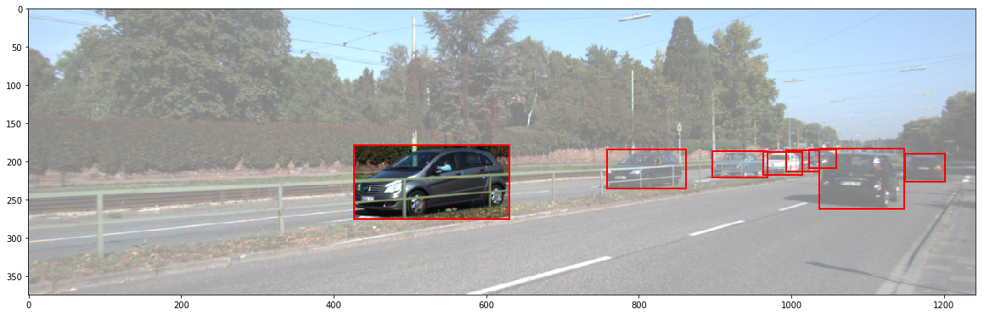
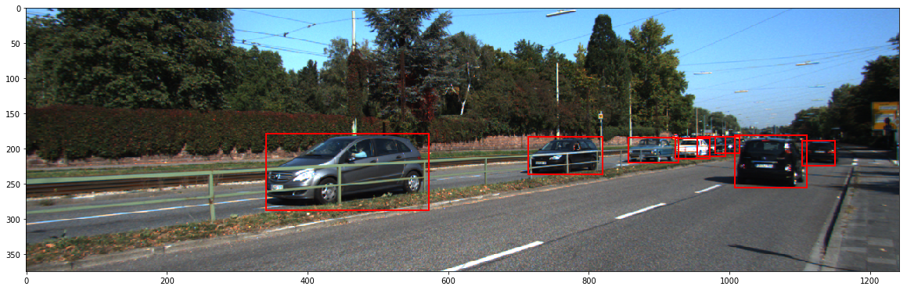
Multi-Object Tracking(MOT)
MOT: Assigning ID to objects so that the same object has the same ID across time.
1
2
1
3
2
0
3
0
4
4
T=t
T=t+1

Slide 3
Traditional approach
Use image-based similarity measures
2D bounding box IoU (intersection over union)
Appearance similarity using Siamese networks
Challenge: overlapping detections, occlusions
T=t
T=t+1

Slide 4
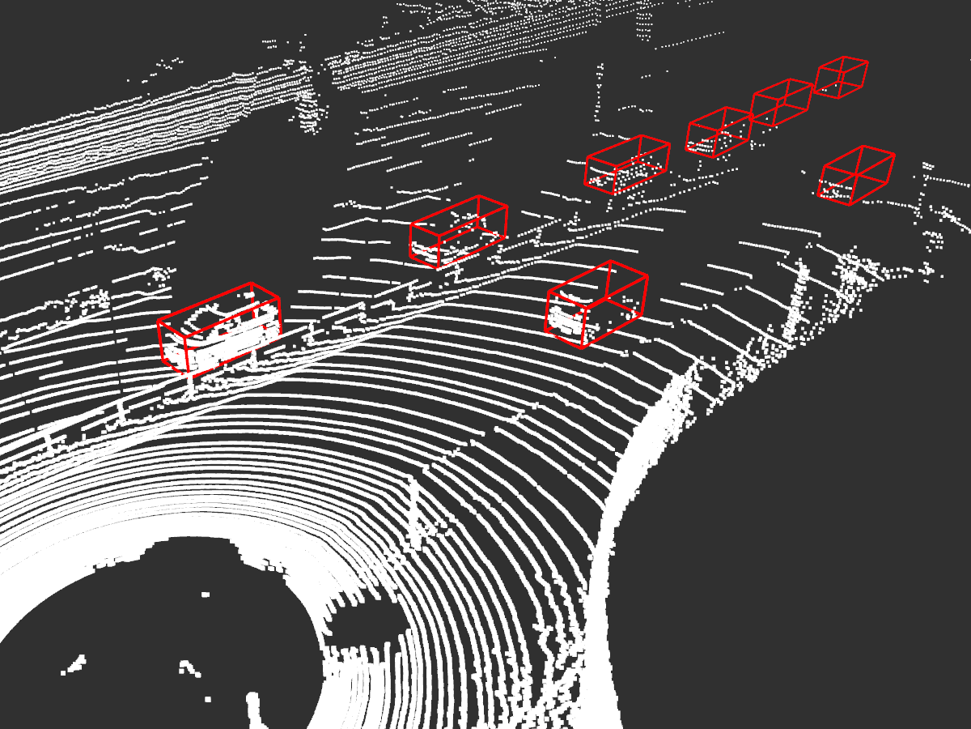
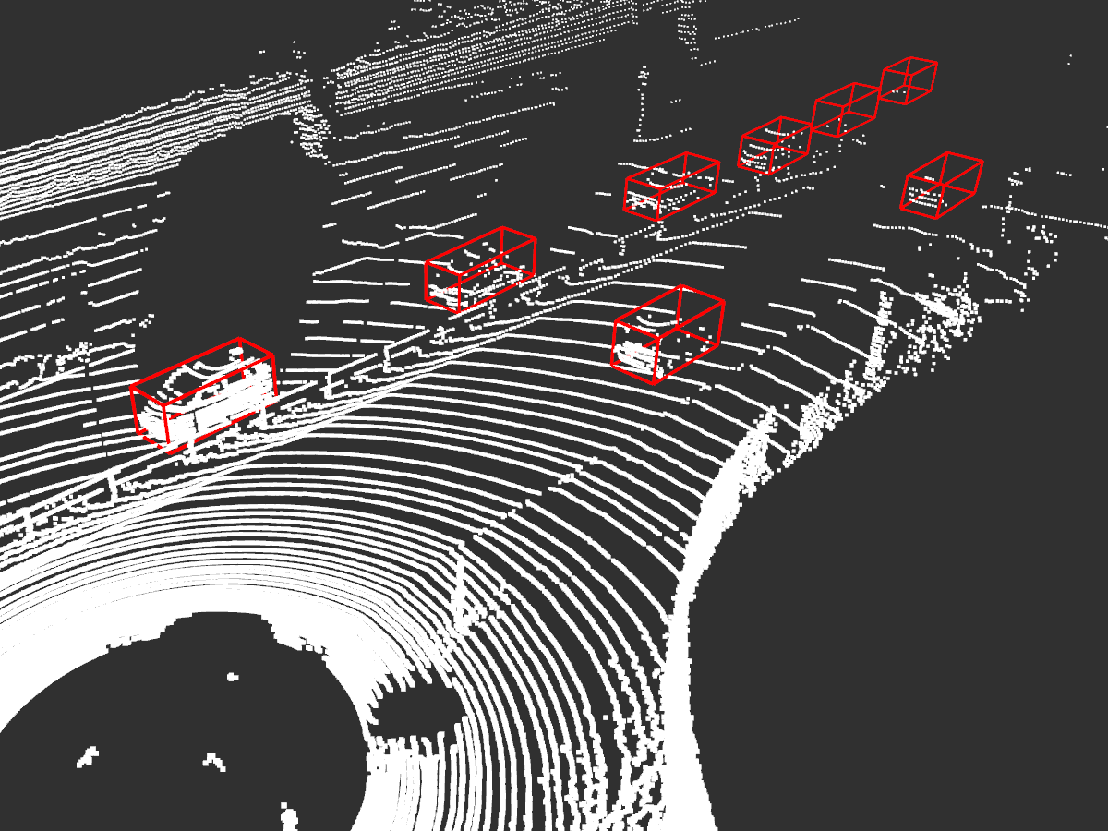
Our approach: add 3D information
T=t
T=t+1

Slide 5
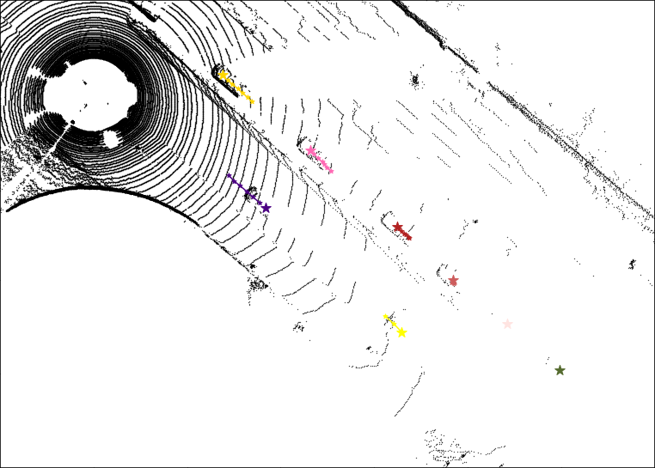
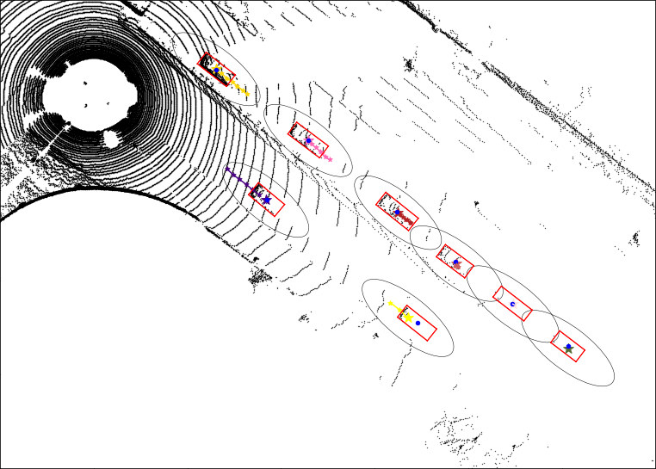
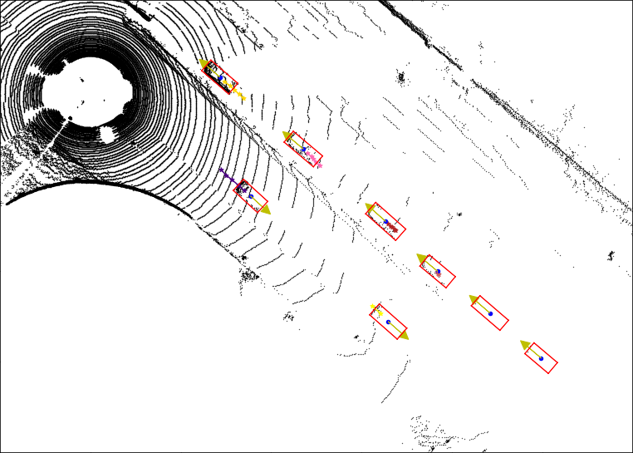


3D similarity
Consider each location following a 2D Gaussian distribution
3D similarity is the probability of the new center in predicted distribution
T=t
T=t+1

Slide 6
Overall similarity
Traditional
2D box similarity
Bayesian model
(product)
Overall similarity
Appearance similarity
3D box similarity
Our added approach

Slide 7
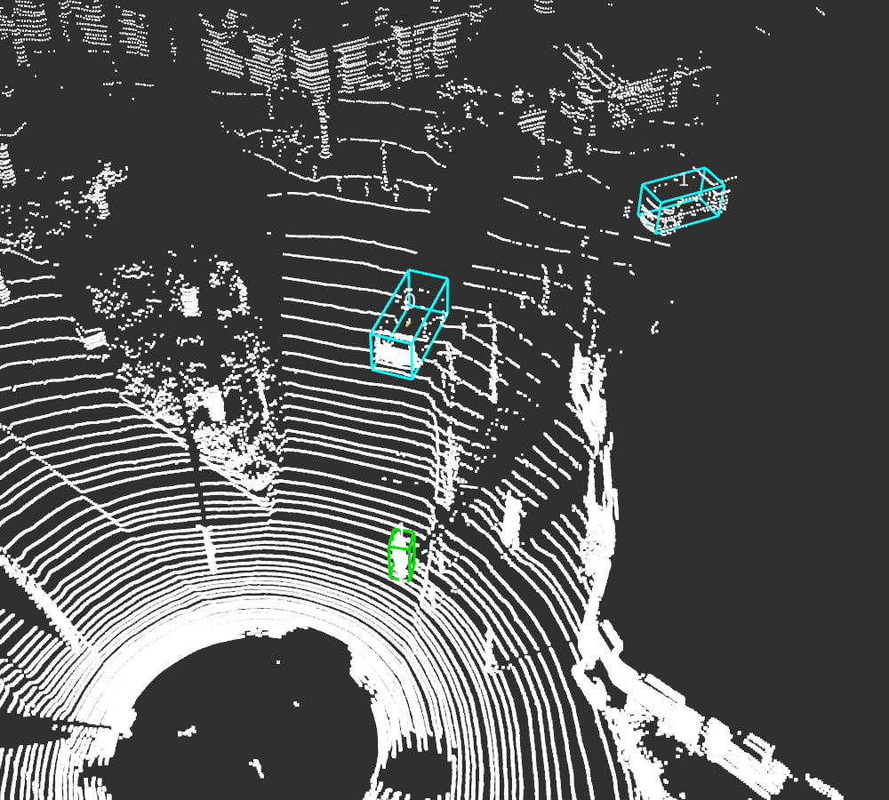
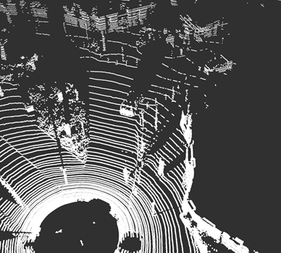
Traditional Tracking-by-Detection
When there are missed detections, trajectory interruptions occur, which degrade tracking performance.
T=t
T=t+1

Slide 8
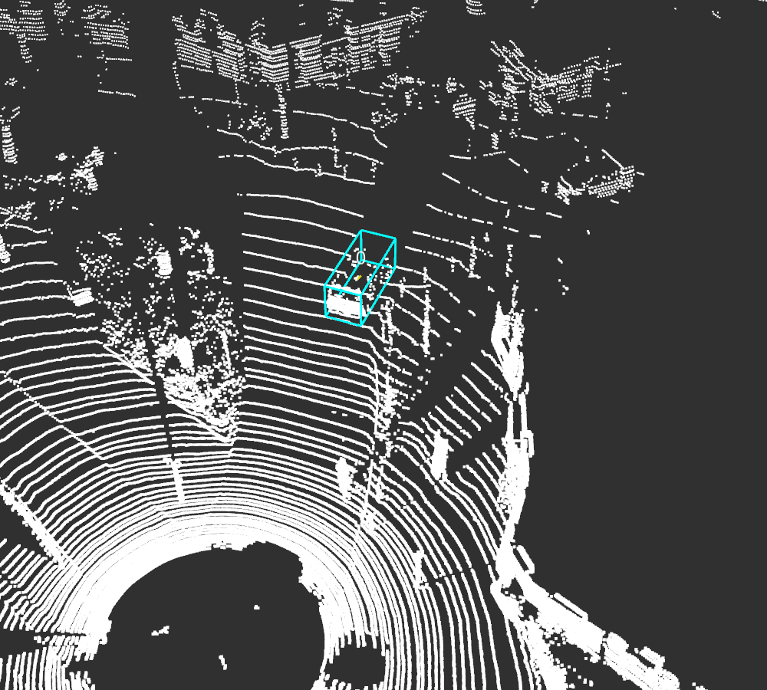
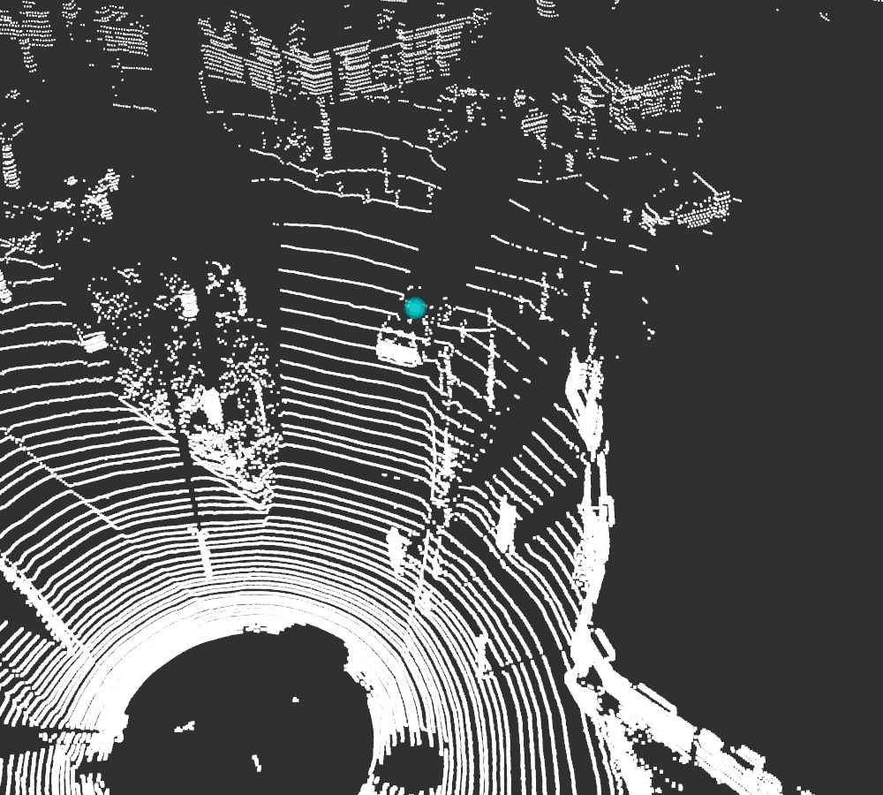
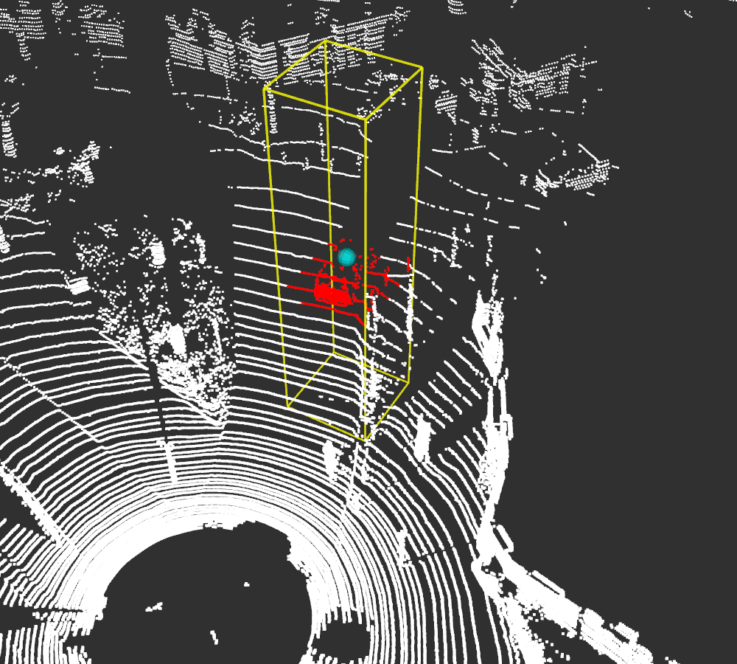
Our approach: Detection-by-Tracking(DBT)
Perform local 3D detection on a restricted region obtained from tracking.
Use a modified version of Frustum-PointNets.

Slide 9
Results on the training set
Car | MOTA↑ | MT↑ | IDS↓ | FRAG↓
2D | 87.98 | 82.57 | 142 | 667
2D+App | 88.03 | 82.57 | 129 | 652
2D+App+3D | 88.53 | 82.57 | 8 | 537
2D+App+3D+DBT | 88.72 | 83.27 | 10 | 455
Pedestrian | MOTA↑ | MT↑ | IDS↓ | FRAG↓
2D | 67.91 | 57.49 | 702 | 1172
2D+App | 68.71 | 57.49 | 613 | 1086
2D+App+3D | 73.28 | 57.49 | 105 | 618
2D+App+3D+DBT | 75.04 | 71.26 | 151 | 578
↑:higher value is better ↓:lower value is better

Slide 10
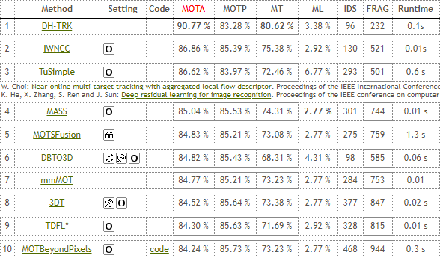
Results on the testing set (2019/05/10)
Car

Slide 11
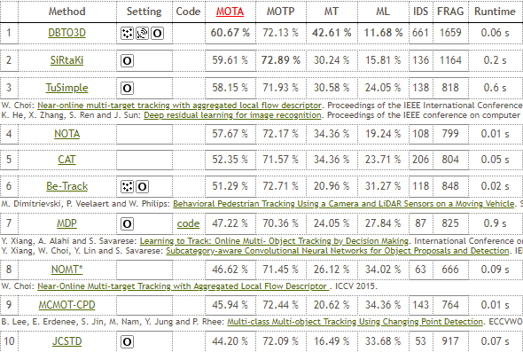
Results on the testing set (2019/05/10)
Pedestrian

Slide 12
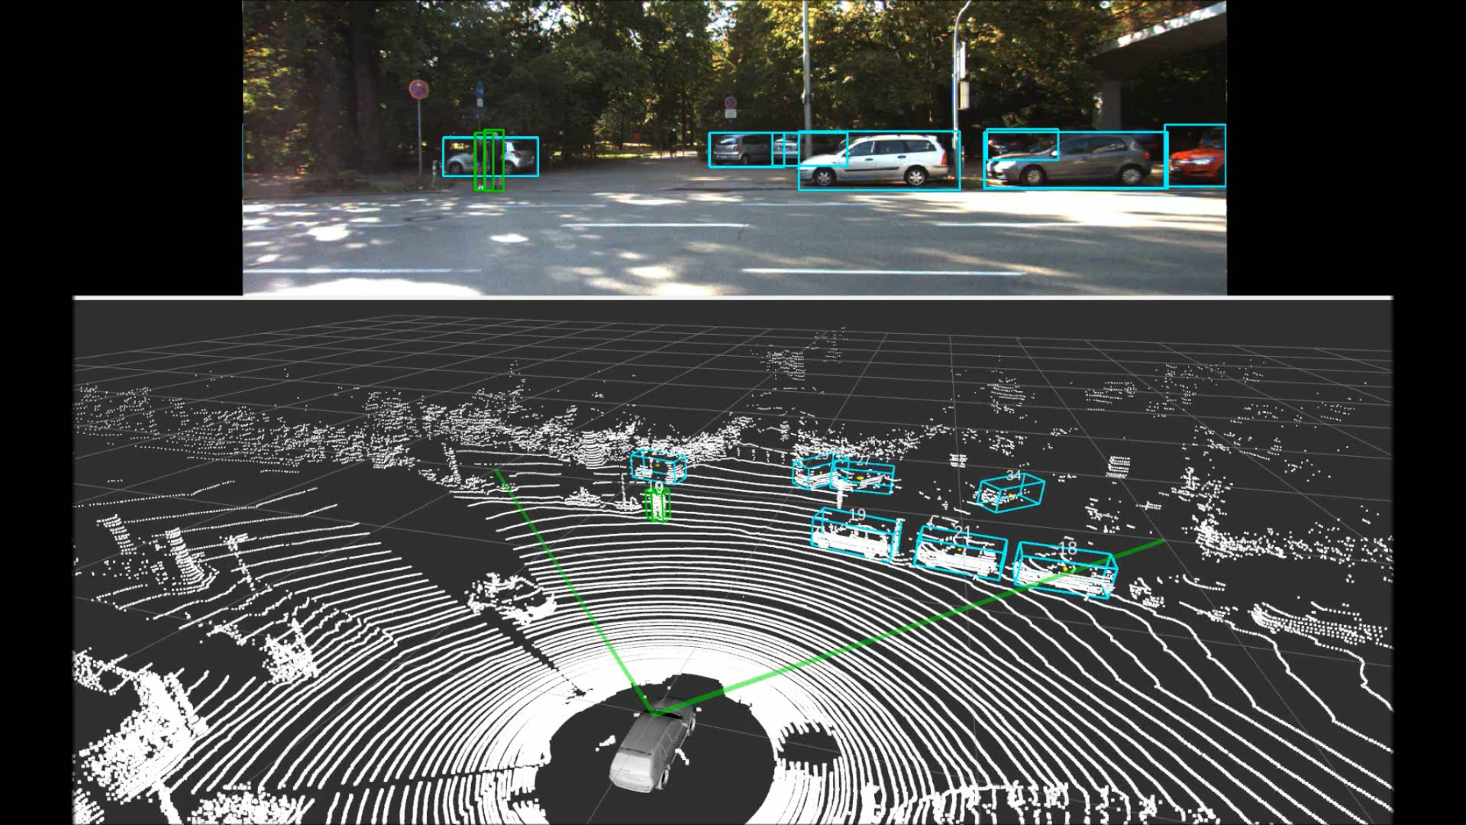
Qualitative result

Slide 13
Conclusion
Contributions:
Add 3D information to tracking
Novel detection-by-tracking method to recover lost objects

